Slide 1
Rectus Extraocular Muscle Size and Pulley Location in Concomitant and Pattern Exotropia
Hao, Rui, et al. "Rectus extraocular muscle size and pulley location in concomitant and pattern exotropia." Ophthalmology 123.9 (2016): 2004-2012.

Slide 2
Purpose: To determine whether rectus extraocular muscle (EOM) sizes and pulley locations contribute to exotropia, we used magnetic resonance imaging (MRI) to measure these factors in normal control participants and in patients with concomitant and pattern exotropia.
Design: Prospective case-control study.
Participants: Nine patients with concomitant exotropia, 6 patients with pattern exotropia (2 patients with A-pattern exotropia, 2 with V-pattern exotropia, and 2 with Y-pattern exotropia), and 21 orthotropic normal control participants.

Slide 3
Pulleys
connective tissue sleeves composed of elastin, collagen, and, in some cases, smooth muscle At the points of EOM transit through posterior Tenon’s fascia
limit sideslip over the globe of the posterior EOM paths during duction, and in the process influencing EOM pulling direction.
in eccentric gazes, the pulleys prevent shift of the straight posterior paths of the EOM
The anatomic point of sharp inflection between the stable posterior EOM path versus the moving anterior path defines each pulley location functionally.
Heterotopic (displaced) pulleys have been proposed to be among the causes of incomitant strabismus
Pulley heterotopy can misdirect EOM force to produce overelevation or underelevation in adduction that may simulate oblique EOM overcontraction or undercontraction.

Slide 4
Methods
high-resolution T1- or T2-weighted MRI and surface coils including monocular fixation of a centered afocal target by the eye scanned to eliminate eye position as a potential confounder.
In most cases, imaging was performed in central gaze, supraduction, and infraduction, enabling determination of the anteroposterior locations of the horizontal rectus pulleys from the inflections in EOM paths in the eccentric gazes.
All cases of exotropia were constant rather than intermittent. Exotropic patients had similar visual acuity bilaterally. By prism and cover testing, pa-tients with A-pattern disease exhibited exotropia at least 10 prism diopters more in infraversion than supraversion. Patients with V- pattern exotropia had exotropia of at least 15 prism diopters more in supraversion than infraversion.

Slide 5
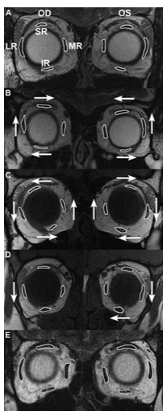
Magnetic resonance imaging scans from representative subject groups:
(A) normal (T2-weighted image);
(B) A-pattern exotropia, in which lateral rectus (LR) muscles are displaced superiorly, inferior rectus (IR) muscles are displaced laterally, and superior rectus (SR) muscles are displaced medially (T2-weighted image);
(C) V-pattern exotropia, in which array of all rectus muscles is excyclorotated bilaterally (T1-weighted image);
(D) Y-pattern exotropia, in which LR muscles in both eyes are displaced inferiorly and the IR muscle in the left eye is displaced nasally (T1-weighted image); and
(E) concomitant exotropia (T2-weighted image). Arrows indicate directions of significant muscle displacements.

Slide 6
Results
Control and concomitant exotropia - rectus cross sections are bilaterally symmetrical, with similar positions of all EOMs
all 6 patients who had exotropia exhibiting V-, Y-, or A-pattern incomitance had at least 1 heterotopic rectus pulley significantly outside the 95% confidence interval of normal.

Slide 7
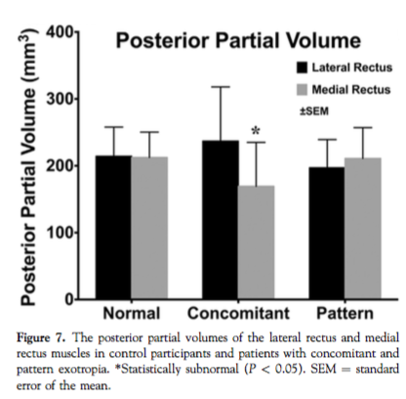
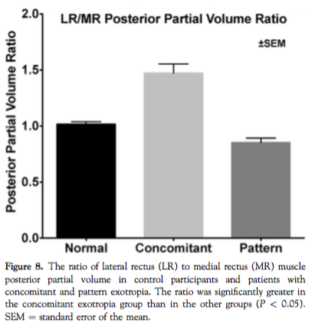
results
Horizontal Rectus Extraocular Muscle Volumes – greater difference between LR and MR muscles in patients with concomitant exotropia
LR/MR ratio of PPV significantly larger in concommitant XT than pattern strabismus and controls

Slide 8
Results
PPV of the SO was approximately 9% smaller in V- and Y-pattern exotropia than in A-pattern exotropia – significance uncertain
Anteroposterior pulley location – posterior rectus paths change in pattern exotropia (anteroposterior location of the LR pulley for the case of V-pattern exotropia in Figure 5 thus may be seen to be normal, inflections of the LR muscle path during vertical gaze shift were 1 to 3 mm inferior to the vertical extent of the normal pulley location)
  BUT in discussion: Anteroposterior locations of the LR and MR pulleys were normal in the cases of A- and V-pattern exotropia that were examined

Slide 9
conclusions
Abnormalities of EOMs and pulleys contribute differently in pattern versus concomitant exotropia. Abnormal rectus pulley locations derange EOM pulling directions that contribute to pattern exotropia, but in concomitant exotropia, pulley locations are normal, and relatively small medial rectus size reduces relative adducting force.
Arrangement of pulleys similar in a healthy control and concomitant exotropia

Slide 10
conclusions
Abnormal rectus pulley locations may explain why some cases of pattern strabismus respond poorly to oblique EOM surgery.
displacement of rectus pulleys perpendicular to their planes of action by only a few millimeters may increase the risk of strabismus by altering EOM pulling directions sufficiently to exceed compensatory capabilities of fusional vergence

